Slide 1

CMR COLLEGE OF ENGINEERING & TECHNOLOGY (UGC AUTONOMOUS) KANDLAKOYA, MEDCHAL ROAD, HYDERABAD – 501401 DEPARTMENT OF COMPUTER SCIENCE AND ENGINEERING
Project title | NEWS I/O
Name | Roll No | Batch No
1. G. Kranthi Kumar | 19H51A05N1 | B88
2. K.Vinay Bhargav | 19H51A05N5 | B88
3. B. Hemanth | 19H51A05M9 | B88
Name of the Guide | Ms. A.Deepika

Slide 2
ABSTRACT
The name of our project is NEWS I/O.
It is a website that helps to know about the covid cases all over India.
This using react js & sass.
It helps us know about the news which take place all over the world.
It is done by React js , Context API , Local storage , Ant design .

Slide 3
INTRODUCTION
The NEWS I/O is a WEB application that helps to keep an accurate record of news which take place all over the world based on categories.
In this website news is categorized into different portals.
This NEWS I/O is a different from other news apps like it shows news which happens all over the world and also show top news all over world.
It show top news channel of every country and home pages contains India top news and tech trends.
This website also have covid tracker so that we can track the covid cases from this website and be aware .
This can build some kind of discipline by becoming aware of what happening around the world . This increases awareness.

Slide 4
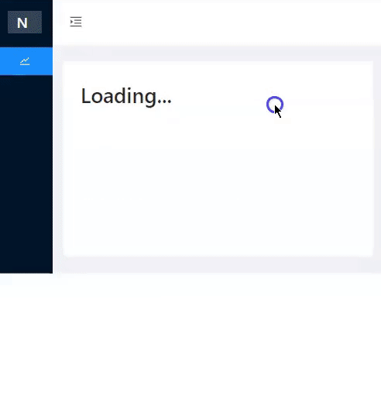
OBJECTIVE
Objective: The main objective of our project is to display world wide news.
It displays the top news of every country.
We can choose the desired news portal we want the news about.
It also has an additional feature based on the pandemic situation .We can also know the insights of COVID cases

Slide 5


PRE REQUISITES/TECHNOLOGY USED
React js , sass ,node js.
VS Code
Knowledge of Front End Development
Git & Github

Slide 6


ADVANTAGES
The NEWS I/O keeps you updated and provides important educational value.
It saves you time by gathering the news.
It helps to open up your mind to new things and ideas.
It make your way easy to know other country news.
You Learn Of Things Going On In Your Community.

Slide 7
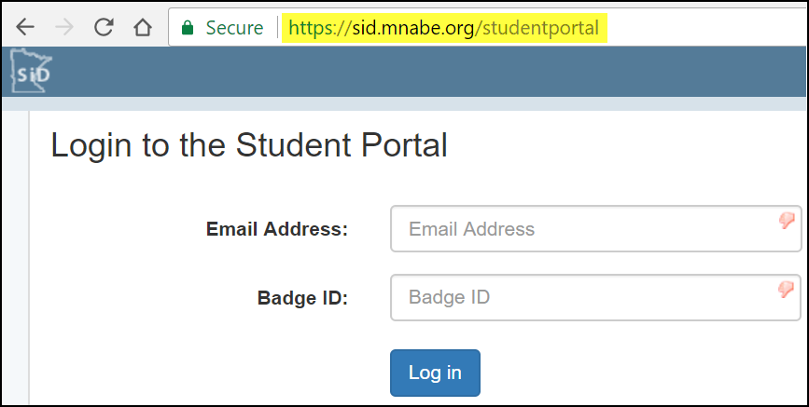

DISADVANTAGES
We cannot update the news manually
As it is a developer API news updates will be slow.
API maintenance is required.

Slide 8

EXISTING MODELS :
Alltop
AllTop aggregates news and blog articles from the world’s most popular websites like TechCrunch, Mashable, BBC, CNN, and more. It curates and displays content in the real-time.
Besides the most recent news, it has a viral category where it showcases the latest viral content and trends.

Slide 9

Panda
Quite different from the above news aggregators, Panda aggregates content useful to web designers, developers, and tech entrepreneurs. It gathers content from Dribble, Behance, TechCrunch, Wired, and other similar websites.
Techmeme
A brilliant technology-themed aggregator site that pulls in tech stories from all over the spectrum. It includes sites like Reddit alongside breaking business news.
You’ll see that each article contains access to other sources, as well as the conversation happening on social. There’s a lot happening on the front page and there’s not much padding between the columns.

Slide 10
PROPOSED METHODS
Our main objective is to display world wide news at a single place
Our aim is to make this app user friendly
This is done by using react
This app is developed using java script language
This is helpful for people who cannot make out time from their busy schedule to catch up with news
This app is also very informative as keep us informed about current
pandemic situation

Slide 11
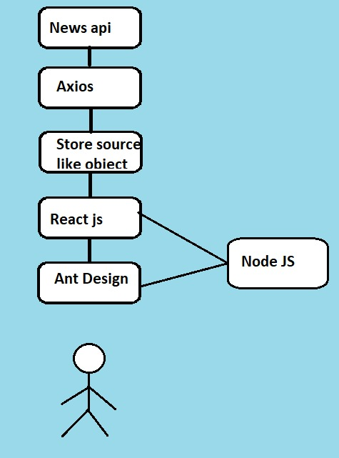
Flow Chart

Slide 12


FUTURE SCOPE
In future we can improve this website by adding sign in/login page.
We can further add different languages ,so that people can feel more comfortable to use it.
We can recommend news according to user taste.
We can convert it into mobile app

Slide 13
REFERENCES
https://newsapi.org/
https://www.covid19india.org/
https://stackoverflow.com/
https://github.com/kranthi0212/newsio

Slide 14
THANK YOU

